Slide 1
Managing data: files and directories
Andrei Petrovski
( a.petrovski@rgu.ac.uk)
CM530– System Programming and Security

Slide 2
Overview
Controlling Files (Elementary Information Security - Chapter 3)
Sharing Files (Elementary Information Security - Chapter 4)
Storing Files (Elementary Information Security - Chapter 5)
School of Computing Science and DM, RGU

Slide 3
Controlling files

Slide 4
Overview
The file system and file access rights
Executable files
Computer viruses and malware
Policies for file protection
Security controls and file permission flags
Information states
Security patching
Process example: the Trojan horse

Slide 5
The File System
Modern computers keep files in a hierarchy of names – a hierarchy of “folders” or “directories”
Each file has a path name
Identifies the directory entries to follow to find the file
The file name selects the right file in the final directory in the path
Files are owned by a user, usually the creator
Access rights are tied to user identities
Example: Bob can read the file, but Alice can’t

Slide 6
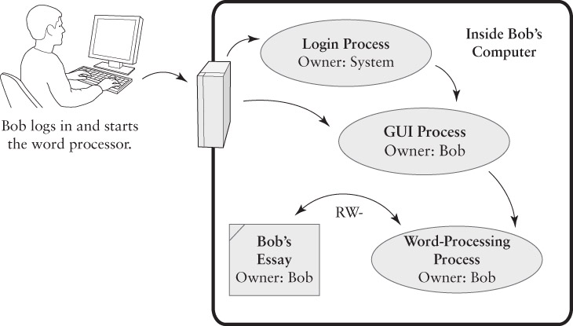
Process Ownership and Access

Slide 7
File and Directory Access Rights
“CRUD” – Create, Read, Update, Delete
Many systems let us control those rights
Different effects on files and directories
“Update” to directory = “delete” to its files
Protecting a newly-created file: two strategies
Use “Defaults” – apply the same access rights to all new files
Use “Inheritance” – apply the access rights based on the enclosing directories

Slide 8
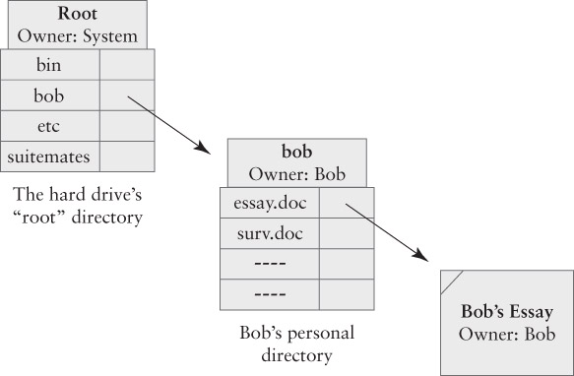
File and Directory Ownership

Slide 9
Executable Files
Files that contain applications or other executable programs
“Binary executables” are stored in a control section and executed by the CPU
“Scripts” contain text interpreted by a programming language interpreter
Execute Access Right
Helps distinguish data files from programs
Must have the “Execute” right to execute a file containing a program

Slide 10
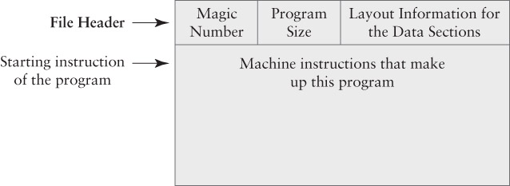
Format of a Binary Executable File
Application programs
OS kernel
Device drivers
Shared libraries

Slide 11
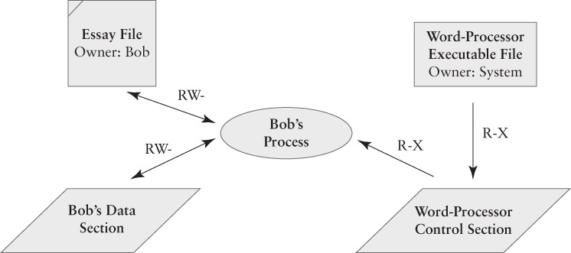
Executable Access Rights

Slide 12
Computer Viruses
A type of malware that enters computer systems.
Malware = malicious software
Viruses are carried by programs
When the program executes, the virus spreads to other programs on the computer
Types of virus infection
Application program infects when it is run
Boot sector virus infects when bootstrapped
USB virus infects when plugged in
Email virus infects if attachment is run

Slide 13
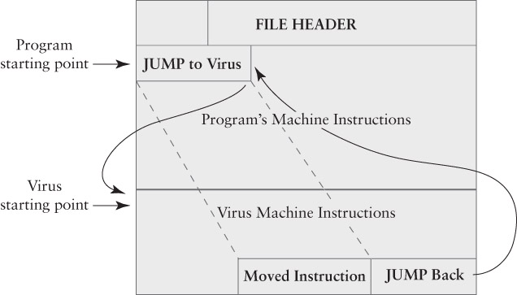
An Infected Application Program

Slide 14
Examples of Modern Malware
Waledac – spreads through email – creates a botnet that spreads spam and more malware.
Conficker or Downadup – spread through Internet via Windows vulnerabilities – created a botnet used for spam and malware distribution.
Pushdo/Cutwail – A botnet and spam package that used to produce 7 million messages a day.
ZeuS – creates botnet focused on financial fraud
Stuxnet – attacks control logic in industrial plants; probable target was Iranian nuclear sites

Slide 15
Sharing and Protecting Files
Objectives for sharing files
Provide computing facilities for authorized users
Preserve the Chain of Control
Permit/prevent general sharing among users

Slide 16
Policy Alternatives
Global Policies – applied to all users by default
Isolation Policy – keep users separate
Sharing Policy – let users share their files
Tailored Policies
Modify rights for specific sets of files
Specific tailoring
Privacy – block some files from sharing
Shared reading – share some blocked files
Shared updating – full rights for some users

Slide 17
Security Controls
An operating system can protect files as long as:
The OS protections are always applied when we access our files, and
There is no way to bypass the OS protections
Basic Principle: Deny by Default
We always start by granting no access
We add access rights
This makes it easier to assign the right permissions and achieve Least Privilege

Slide 18
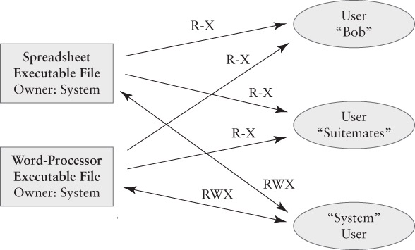
Executable Access Rights

Slide 19
Managing Access Rights
Access Matrix contains two dimensions
A full matrix is too large for practical use
We can organize access rights by clustering in one dimension or the other
Cluster by Column = Capability-Based Security
We associate rights with users, processes, or other active entities
A key-ring is a set of capabilities: ownership grants access to the locked items
Tickets provide capabilities

Slide 20
Cluster by Row = File Permission
Currently the most popular strategy in OSes
Access rights are associated with resources like files, devices, storage areas, etc.
The list of rights tells which users/processes have which access rights.
Implementations:
File Permission Flags – Unix
Access Control Lists – Windows, OS X
Control or Data Section | P #1 | P #2 | OS
Control Section | R- | R- | RW
Process #1 Data Section | RW | -- | RW
Process #2 Data Section | -- | RW | RW

Slide 21
Permission Flags in General
Sets of flags to specify access rights. Example:
RWX = Read, Write, Execute access rights
A set of flags for each type of process
Processes belonging to the file’s owner
Processes belonging to the system
Processes belonging to others – the world
Still too redundant: owner and system often have full access to the files anyway
Compact access rules specify world rights only.
CHMOD should ring a bell here:
chmod 755 thisfile.doc
Why are there 3 numbers?
What do the 3 numbers mean?

Slide 22
States and State Diagrams
A technique to illustrate a system’s behavior
Each state is a separate situation
Arrows between states show transitions
A transition indicates both cause and effect
An event causes the transition
An action may take place at the transition
A door may be Open or Closed – two states
The events Opening or Closing cause the transition between the states

Slide 23
Information States
Data or information may be in these basic states
Storage state
Stored in a computer, not being processed
“Data at rest”
Processing state
Being used by an active process
Usually stored in RAM
Transmission state
Being moved from one place to another
“Data in motion”

Slide 24
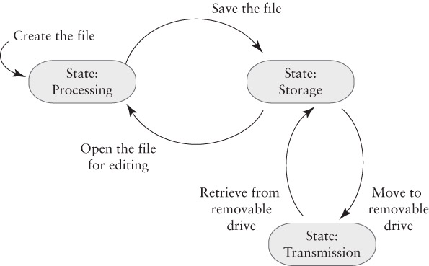
An Example

Slide 25
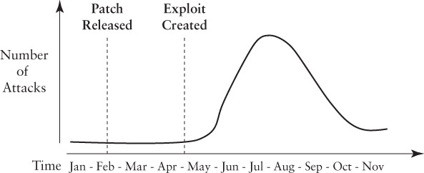
A Second Example
A race begins when a security problem arises
The software developer races to develop a fix to eliminate the problem
Attackers race to write software that exploits the problem and lets them attack computers
Attack software is called an exploit
Any computer that does not patch the problem may be vulnerable to the exploit
Window of vulnerability = time during which an exploit exists but computers aren’t patched

Slide 26
Patching Security Flaws
The Patching Process
Collect error reports
Prioritize errors and assign to engineers
Engineer develops software to fix the error
Software fixes are chosen for a patch
The patch is tested
The patch is released
This applies to all flaws including security flaws
Security fixes may have higher priority

Slide 27
The Risk of Delaying Patching

Slide 28
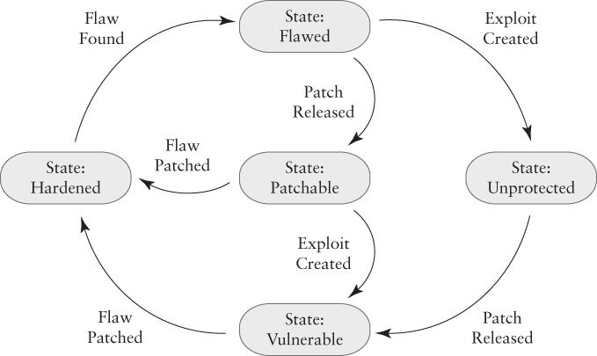
A State Model of Patching

Slide 29
sharing files

Slide 30
Overview
Tailored File Sharing
User Groups
File Permission Flags
Access Control Lists
Windows Access Control Lists

Slide 31
Tailored File Sharing
Example
Bob and Tina shall be able to read and modify the survey data
No one except Bob and Tina have access to the survey data
When tailoring, we answer 4 questions
Which resources are we managing?
Which users have access?
Deny by Default or modify the existing rights?
What access rights do non-owners have?

Slide 32
How do we tailor the access rights?
Cannot do it with simple permission flags or with compact access rules
We need more than just Owner, System, or World
Simple File Sharing on Windows
Keeps a list of users granted access to a particular directory tree
Access Options:
Co-owner access, Owner access
Read-only access
Read/write access

Slide 33
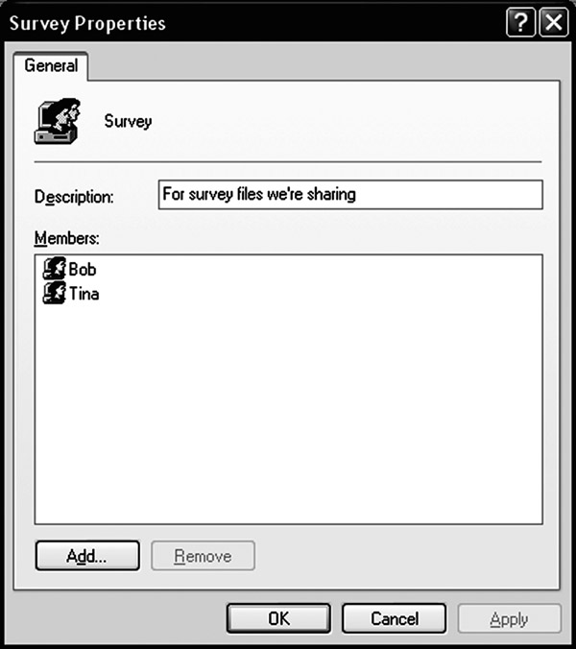
User Groups
Each file has a set of group access rights, and the ID of an established group of users
“World” is a group that contains all users
Other groups must have a file that lists the users in each group
The OS applies group rights, as well as other rights, when deciding whether a process is allowed access to a resource.
We create a group by creating a list of users in that group, and then giving the group a name.

Slide 34
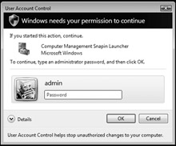
Administrative Groups
Many systems have a separate “Admin” group
User IDs who are part of the group may perform administrative tasks
Restrict access to administrative functions by blocking the right to execute the programs
Windows also associates other privileges with user groups, including administrative rights
If a user is in the “Admin” group, they automatically have access to administrative functions

Slide 35
Privileged User IDs
Classic Unix had a “root” user ID
Admins logged in as “root” to perform administrative tasks
Problem: the system couldn’t tell which admin performed a particular task - Accountability
Modern Unix has “SUDO” and “SetUID”
User with administrative role uses one of these commands to execute a privileged operation as “root”
Similar to OS-X “unlock” and Windows UAC

Slide 36
Administration and Least Privilege
Administrative roles pose a danger
If an admin user executes a Trojan horse program or a virus, the malware can use the administrative rights to modify the OS itself
This risk applies to “root” users and to members of “admin” user groups
Safe alternative: temporary rights (UAC)
Safe alternative: Have two User IDs
Regular user ID has no special privileges
Special user ID has administrative privileges

Slide 37
File Permission Flags
Traditional Unix uses file permission flags to indicate access rights
Modern Unix systems may also use access control lists (ACLs) – will discuss later
Three sets of RWX flags
Owner Rights (called “user rights” or “u”)
Group Rights (called “group rights” or “g”)
World Rights (called “other rights” or “o”)
Specified in that order: owner-group-world
“rwxrwxrwx” gives everyone full access rights

Slide 38
Unix Permission Flags
Unix keyboard commands use these codes to specify and report on file access rights
Example: “ls” the list directory command:
data1.txt and hello.c are text files
hello is an executable file, owned by “rick”
Everyone can read them, owner can write them
$ ls -l
total 56
-rw-r--r--@ 1 rick ops 4321 Nov 23 08:58 data1.txt
-rwxr-xr-x 1 rick ops 12588 Nov 23 10:19 hello
-rw-r--r--@ 1 rick rick 59 Nov 23 10:18 hello.c

Slide 39
Permissions and Ambiguity
Can Tina read a file with these permissions:
Owner: Bob – RWX
Group: Survey (Bob and Tina) – no access
World: R—
Answer: depends on the operating system
On Windows: YES
Permissions are combined, then checked
On Unix: NO
Applies the list that applies closest to Tina: the group permissions

Slide 40
Access Control Lists (ACLs)
The general-purpose technique cluster access rights by row (by resource, by file)
Simple permission flags require a small, fixed amount of storage for each file
ACLs may be arbitrarily long
Poses a challenge for the OS
An alternative to User Groups
We simply keep a list of individuals with the right to access a particular file or folder
Efficient if each file needs its own tailored list

Slide 41
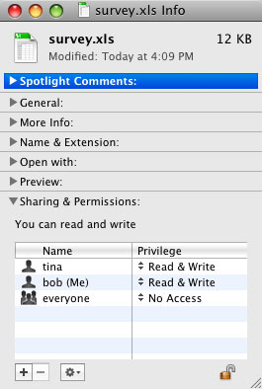
OS-X ACLs
Based on Unix permission flags
Provides owner/group/ world rights by default
GUI only provides RW access controls
Keyboard commands provide more sophisticated controls

Slide 42
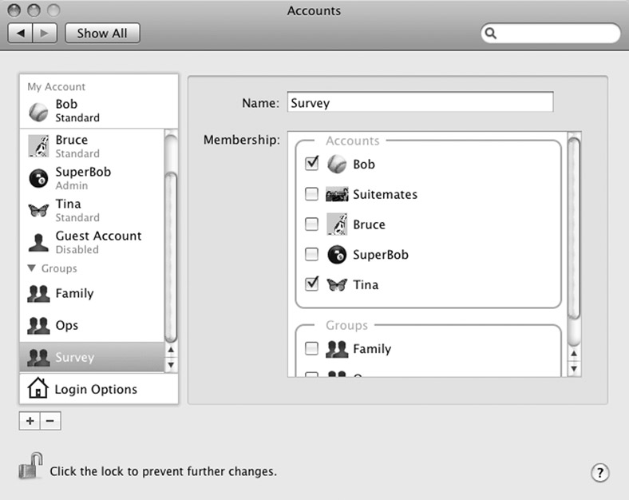
OS-X Groups

Slide 43
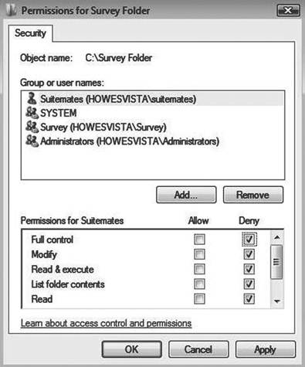
Microsoft Windows ACLs
Present in “Professional,” “Business,” and other sophisticated versions of Windows
“Home” and “Basic” versions use the simple access lists described earlier
Each ACL entry gives permission for a specific user or group
Users and groups are defined on the computer or by a network-wide “Domain”
Each entry specifies a list of permissions
Each permission may be “Permit” or “Deny”

Slide 44
Applying a Windows ACL
Permissions are applied in a specific order:
Permissions specifically assigned to that file or directory are applied first
Next, apply those inherited from the enclosing directory
If more permissions inherited, apply them in inheritance order: most recent to least recent
For each set, we apply Deny rules first
As soon as we find a permission that matches this user or process, we stop and apply it

Slide 45
Building Effective ACLs
Deny by Default is the best general approach
Start with no rights, or a small set of defaults
Permissions to owner and administrators
Add “Allow” rights as needed
Keep the rules as simple as possible
Example that needs a “Deny” right
A group of all students called “Students”
Need a group “Students Minus Freshmen”
Easiest approach: Deny “Freshmen” group

Slide 46
Default File Protection
Windows uses device, directory, and folder rights to establish default protections
The rights are inherited from enclosing folders
Inheritance is dynamic
If we change rights on an outer folder, it may change rights on an inner folder
Most other ACL implementations are static
Changes do not affect existing rights
We can enable and disable inheritance
Often disabled to apply special rights

Slide 47
A Different Trojan Horse
Bob plays a video game that someone has installed in the Suitemates folder.
Bob then discovers that someone has copied his protected files into the Suitemates folder.
How did this happen?
The game was a Trojan horse program
In addition to implementing the game, the program also copied files that Bob owned
It used Bob’s access rights to copy his files

Slide 48
How the attach worked
Transitive Trust – a basic principle
If we trust Program 1, and it trusts Program 2, then we are also trusting Program 2
If we run a program, then we trust its author
Bob trusted the game program: the program copied Bob’s files to Suitemates’ folder
Resources | World access rights | Effective Access By Bob | Effective Access By Suitemates
Bob’s secret files | --- | RW- | ---
Suitemates’ game file | R-X | R-X | RWX
Suitemates’ copy of Bob’s secret files | RW- | RW- | RW-

Slide 49
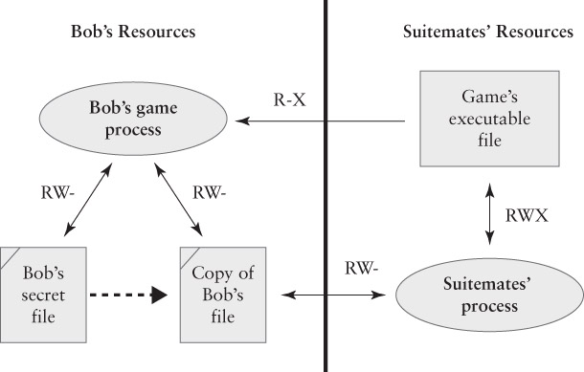
The Trojan in Operation

Slide 50
For the rest of today:
Read through chapters 3, 4 and 5 of Elementary Information Security
Have a go at the associated quizzes on these chapters that is available on Moodle
If you haven’t done the quiz on last weeks chapter have a go at that instead.

Slide 51
For the rest of this session:
More Blackhat
https://www.youtube.com/watch?v=nuruzFqMgIw
This time we are looking at USB devices and how they can be used by the hacking world to in gain access to a system.
Pay particular attention to how they use limitations in the file system to be able to do this.

